Slide 1
EelDeal2030#
Paul Brotherton, Wetlands International Europe

Slide 2
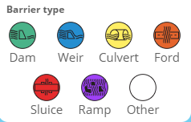
>1 million barriers in European rivers
1 every 1.5 km in the most densely populated countries
Amber Barrier Atlas

Slide 3
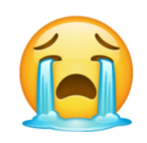
Better Implementation & Integration
Policy tools for free-flowing rivers
European Maritime, Fisheries and Aquaculture Fund
Common Agriculture Policy
Water Framework Directive
Nature Restoration Law

Slide 4
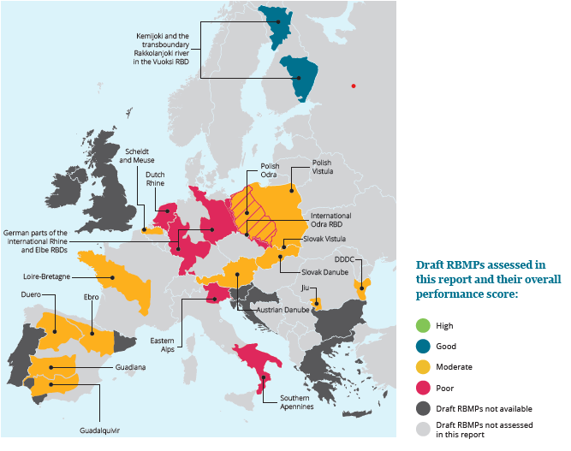
Better Implementation Water Framework Directive
The Final Sprint for European Rivers
By 2027 deadline:
90% of river basins studied will still be unhealthy
2 of 21 river basins might see good health by 2027

Slide 5
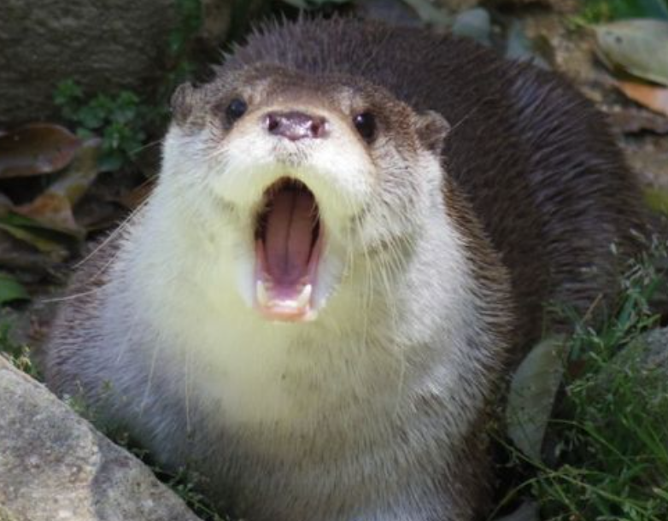
Better Integration
Water Framework Directive – Birds & Habitats Directives
EC 2019 overview: 2nd RBMPs will not bring significant progress status of protected areas
3rd RBMPs - Insufficient:
Resources
Capacity
Time to assess RBMPs
Integration conservation objectives RBMPs
Coordination
Limited knowledge water requirements species & habitats
Economic interests higher priority

Slide 6
25,000 km Free-flowing rivers target by 2030
Pros
Focus on longitudinal and lateral connectivity
Legally binding action plan – inventory and removals
Accelerate WFD, Bird & Habitats Directives + Eel Regulation
Reorient from adapting existing barriers to complete removal
Cons
Only 2% of EU rivers
Not legally binding
No additionality to measure already proposed (RBMPs)

Slide 7
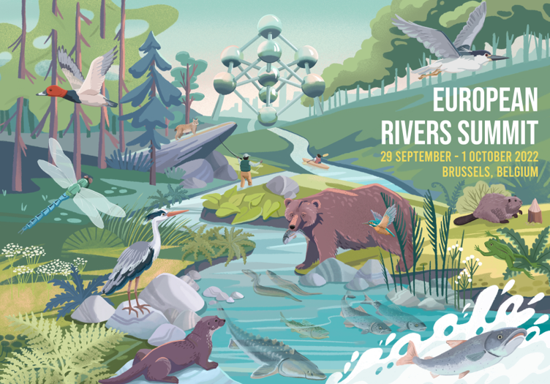
European Rivers Summit - Brussels
September 29 – 1 October

Slide 8
Thank you!
Paul.Brotherton@wetlands.org

