Slide 2
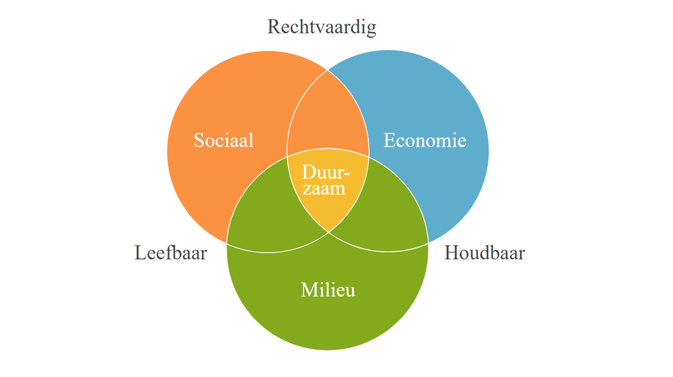
Social
Economic
Environment

Slide 3
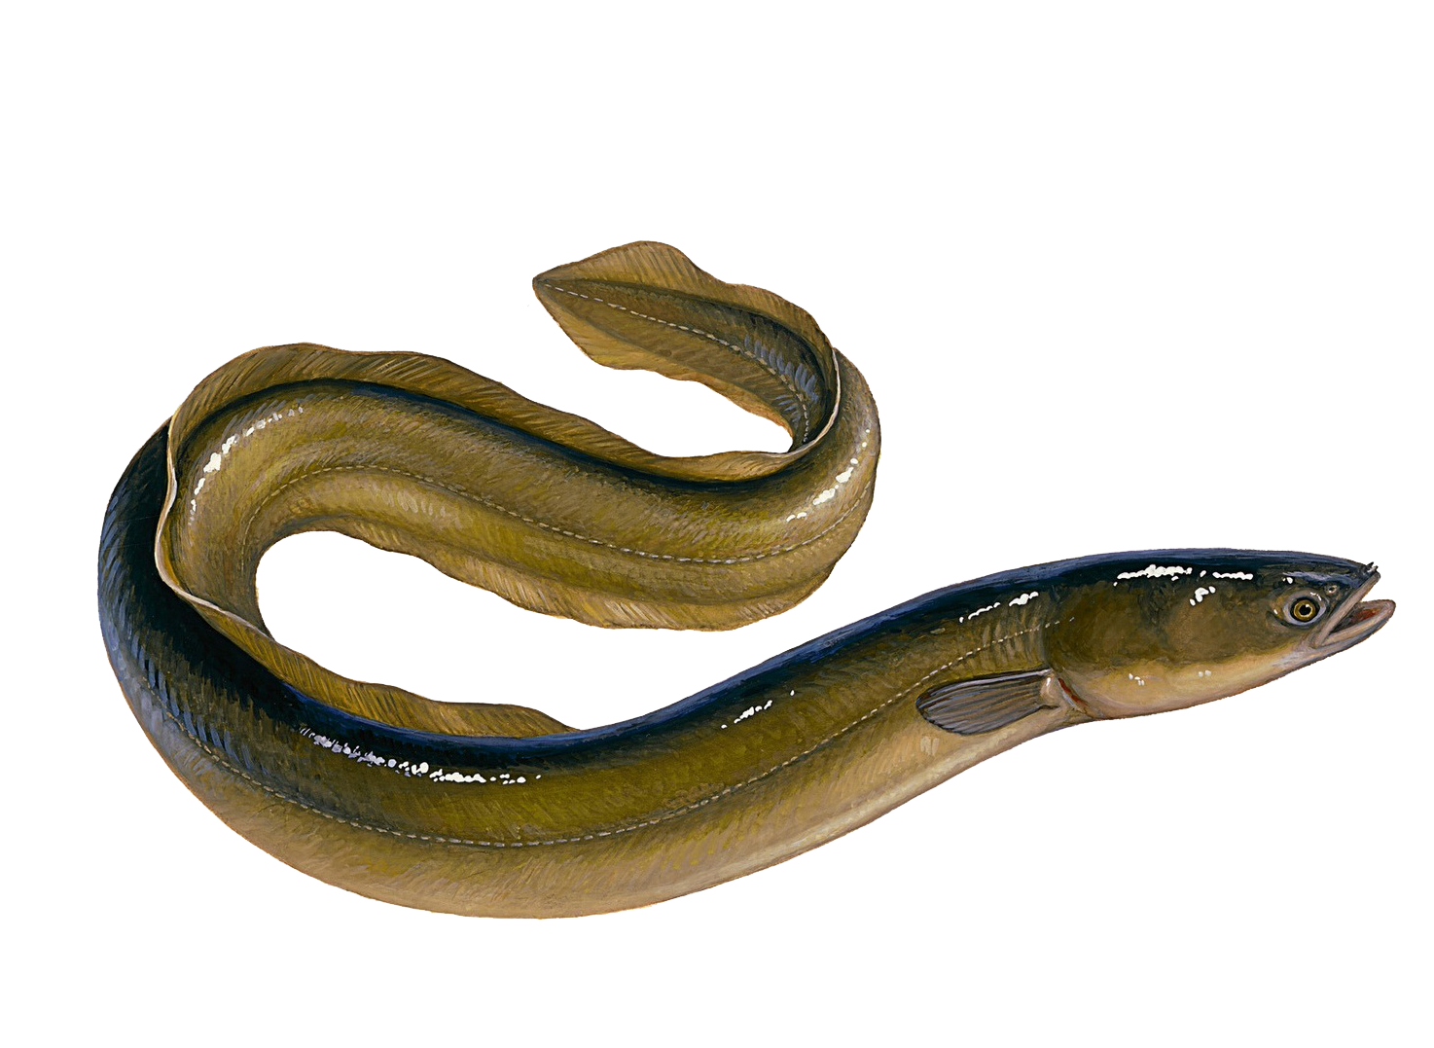
Assessments at this stage are only speculations!

Slide 4
THE EU DEEL ON EELS IS NOT KNOWN
THE STRENGTH OF CONTROL IS ALMOST NIL
NO DATA COLLECTED
MEASURING IMPACT IS VERY DIFFICULT

Slide 5
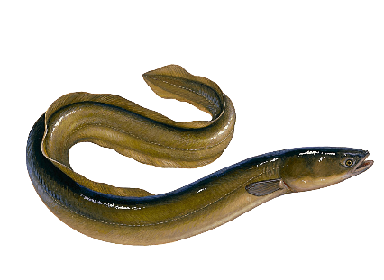
CURRENT SCENARIO
Image
Cost

Slide 6
… a simple but effective solution!

Slide 7
Is measuring to Know, and is Knowing to measure?
Is meten Weten
en is
Het weten te
Meten?

Slide 8
…. THROUGH A STRONG
COLLECTION AND ANALYSIS OF QUANTITATIVE DATA!

Slide 9
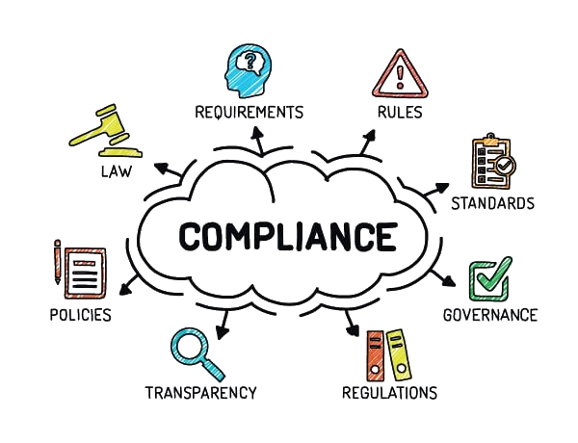
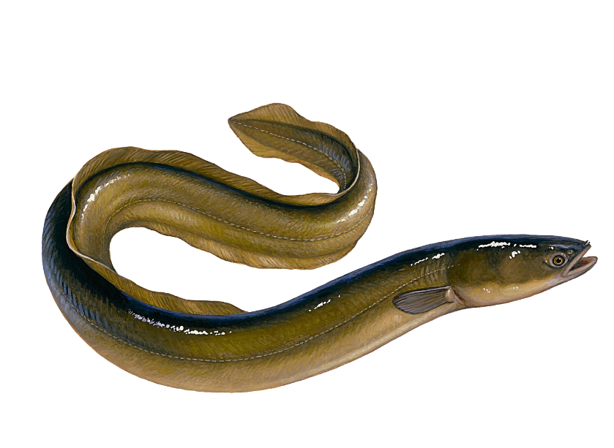

Slide 10
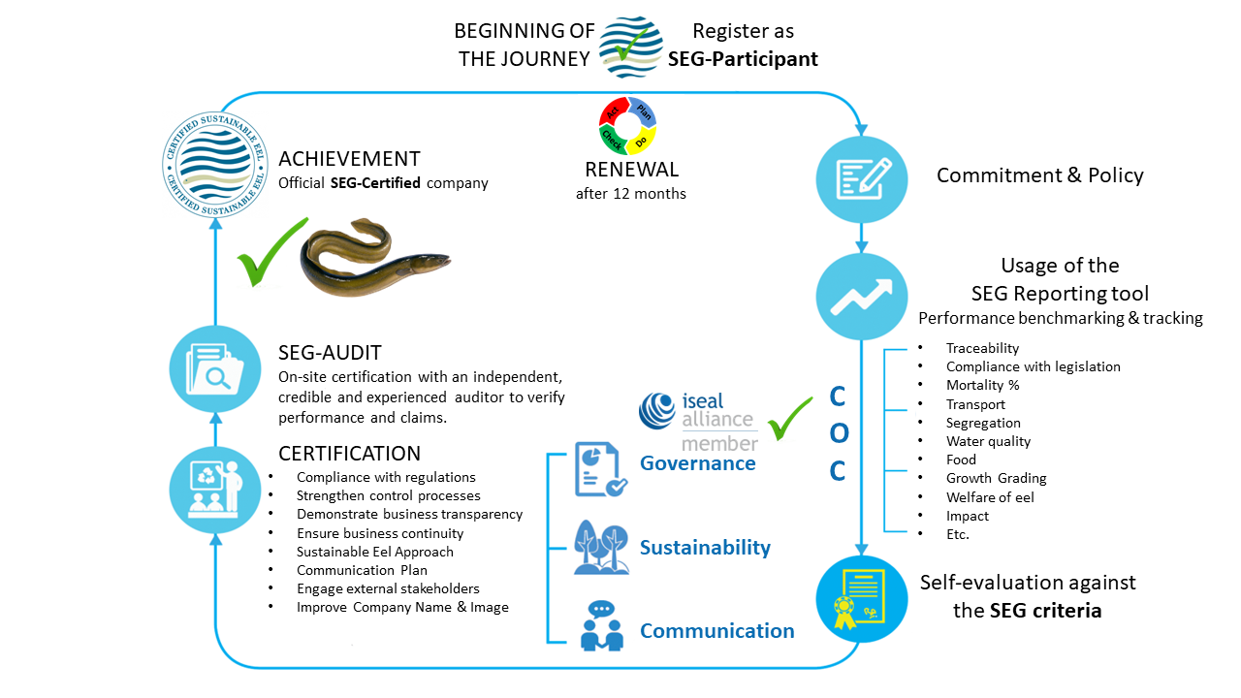

Slide 11
STOPPING DOMINO REACTION

Slide 12
TARGET SCENARIO
Image
Cost

Slide 13
DIRECTIVE (EU) 2016/429 OF THE EUROPEAN PARLIAMENT AND OF THE COUNCIL

Slide 14
These regulations relate to food authorities and not specifically to eel.

Slide 15
Our aim is to prove to all “skeptical consumers”, including supermarkets, that every eel that leaves a company is sustainable.
We need to demonstrate, quantitatively, that controlled consumption is the only way to safeguard the existence of the European eel.

