Slide 1

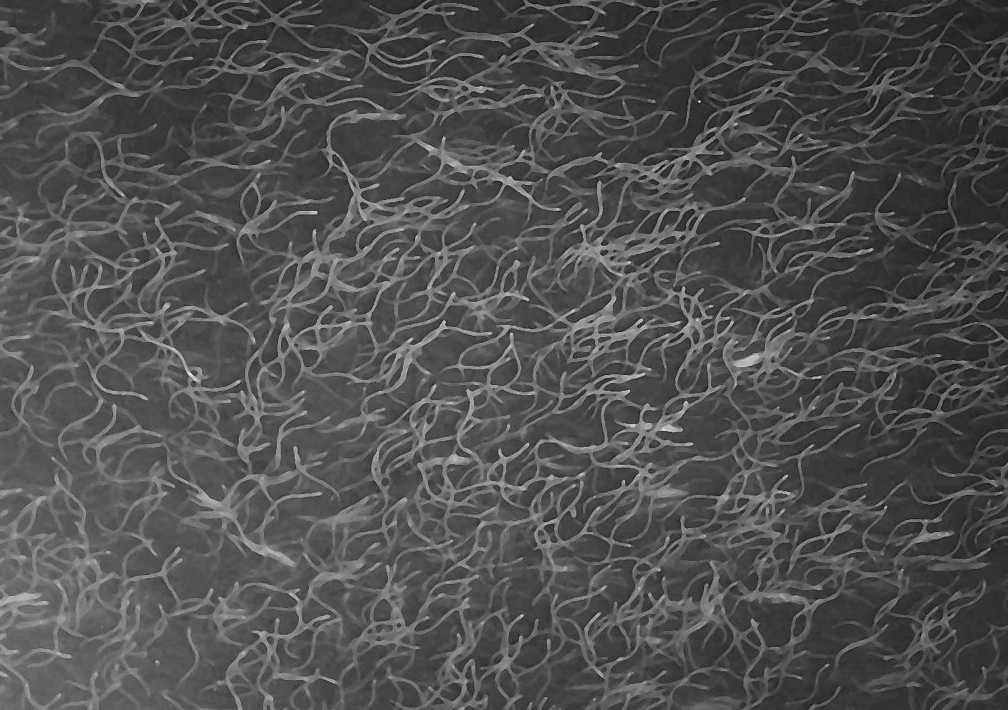

European eel: from pest to protected.
What next?
Sveriges lantbruksuniversitet
Swedish University of Agricultural Sciences
Department of Aquatic Resources
Institute for Freshwater Research
Willem . Dekker @ SLU . SE
ボクハウナギダ

Slide 2
Time trends

Slide 3


Status awareness & responsibilities
Individual alarms:
Anon 1867, Behr 1870, Walter 1910, Röhler 1933, Meyer-Waarden 1967,
Dekker et al. 1993, Sjöstrand & Sparholt 1996, Dekker et al. 2003
1990s: Alarms to fishers, anglers, WWF, IUCN, ICES, FAO, EIFAC, CMS=Bonn, EU-Parl….
‘Eel is over-abundant, so who cares?’ & ‘Eel will demise, but who cares?’
EU-Commission 1998: we are accountable.
2003 core ideas, 2005 text draft, 2007 adopted, 2009 implemented:
EU Eel Regulation - aim ‘to reduce mortality, to enable restoration to 40%’
CITES listing - ban import/export from EU

Slide 4

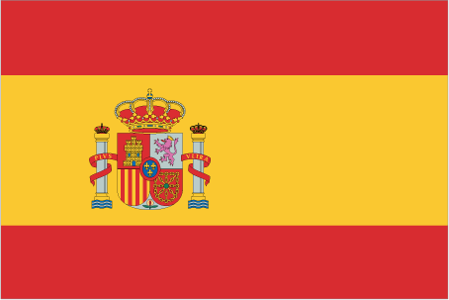


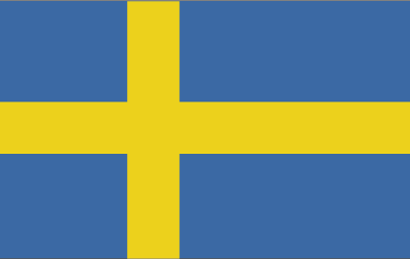
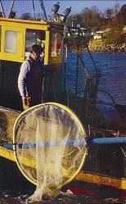
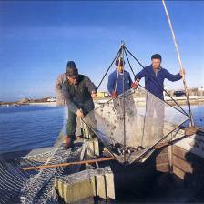
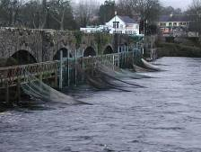
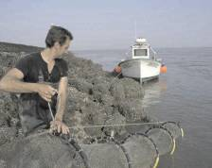
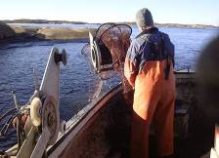
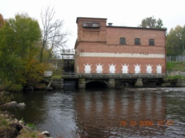

EU Eel Regulation & CITES listing
EU
EU Eel Regulation 2007
Common goal
Reduce mortality, so as to
permit long-term recovery
up to 40% of pristine state.
Common actions
Closed season
Min. legal size
Quota
National implementation
Eel Management Plans
Uniform protective action
Local action in the field
Specific measures & actions
CITES listing, block import/export

Slide 5

Today is the first day of Eternity
Today
Means
Protection, reduce mortality
Short-term (immediate)
≥40% survival current stock
Impacts still too high
Feedback needed!
Eternity
Aims
Recovery, sustainable use
Long-term (decades!)
40% of pristine state
Stock not recovered yet
Low state remains alarming
Today nor Eternity, but #EelDeal-2030:
40% survival
in all areas
by 2030!

Slide 6

(Mother Eel, by Maready Evergreen)
The young eels, that immigrated our rivers this spring,
deserve sustainable protection within their lifetime!

Slide 8

ANIME
Evaluation
Abbott, K.W. and Snidal, D., 2009. The Governance Triangle: Regulatory Standards Institutions and the Shadow of the State. In The politics of global regulation (pp. 44-88). Princeton University Press.

Slide 9
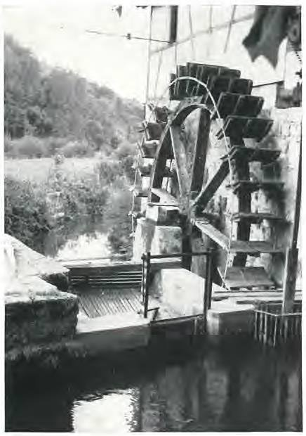
The eel is a pest: an over-abundant, fatty ‘snake’
Fatty eel is hard to digest, especially when smoked – Thiel 1877
Eels clog your tapwater pipes
Monstrous eels in sewage systems
Eels bring hydro-turbines to a stand-still, tough skin
Eels eat all your crayfish, trout & salmon brood
Install barriers in streams to block eel migration – Cairns 1938
Destroy all eel in salmon-waters – Anon 1989

